Slide 1

Online Vehicle Rental System
17BCS089 - Harish Kumar N
17BCS120 - Murugan Ajith Kumar
17BCS218 - Yogeshwaran M

Slide 2
PROBLEM STATEMENT
Everyone buys vehicle for the convenience of traveling anywhere at anytime . For this reason, everyone considers vehicles as an asset but it’s not.
A vehicle will depreciate 10% of its value immediately after we drove off from the showroom and 63% in the first five years. It needs proper maintenance at regular intervals to ensure proper working condition.
We may have more vehicles in our home than we use, or we may see people having more vehicles than they need. Either it will be in a place remaining untouched being a waste of money or resell it for a lesser price. Clearly a vehicle is a liability which loses its value over time.
But there is a way to turn our vehicle into an asset.

Slide 3
OBJECTIVE
Our main objective in this project is to create a user-friendly web-based system for customers to lend and rent vehicle for their convenient use.
The web-based system is aimed to be secured and easy to manage both by the administrator and the users.
The system is aimed to be accessed by a browser on ease that does not demand any hardware or software requirements from the users.

Slide 4
Literature review

Slide 5
Roving vehicle rental system and method - Randall W. MARUSYK, Ottawa (CA); Hilary PHENIX, Ottawa (CA), Year- May 31, 2016.
A method and system for facilitating vehicle rental are provided. Rental request parameters are received from a first party, including a rental start time, a rental pick-up location, a rental end time and a rental drop-off location. A vehicle available for rent between the rental start time and the rental end time is acquired, and delivery of the vehicle to the rental pick-up location is initiated. A transaction with the user may be performed upon delivery. Retrieval of the vehicle from the rental drop-off location is initiated following the rental end time.
LIMITATION:
Requires large human and hardware resources for operation.

Slide 6
Shared vehicle rental system - Katsutoshi Tagami, Asaka; Masaki Ban, Shinjuku-ku; Fumitaka Takahashi, Hoya, Yasushi Okada, Fujimi, all of Japan, Year- Dec 5, 2013
A shared vehicle rental System has a plurality of motor vehicles, a parking area for a plurality of users to rent motor vehicles therefrom and to return motor vehicles thereto, and a control center for Supervising the motor Vehicles. The shared vehicle rental System registers the users in a plurality of groups depending on a usage time Zone in which the users use the motor vehicles, identifies registration information of the users which is recorded on IC cards of the users, and Supervise the motor vehicles and the parking area based on the registration information of the users.
LIMITATION:
Requires land and human resources for operation

Slide 7
Car rental system - Mitsuru Sendouda, Tokyo (JP), Year- Dec 27, 2001
A car rental system receives a rental order specifying the model of a rental car and a delivery location at which the user wishes the rental car to be delivered. The car rental agency delivers the specified rental car to the specified location and leaves the rental car without attending to the user. The user goes to the specified location and then drives the rental car by using a password and a card key previously delivered to the user.
LIMITATION:
Need human resources for implementation.

Slide 8
Remote vehicle rental systems and methods - Randall W. MARUSYK, Ottawa (CA); Hilary PHENIX, Ottawa (CA), Year- Nov 14, 2017
A system for renting vehicles is disclosed. The system can comprise a vehicle access communicator (“VAC”) capable of interfacing with one or more functions of a rental vehicle and a user provided portable electronic device.
The VAC can control various functions of the vehicle including, but not limited to, the door locks and/or enabling/disabling the vehicle. The VAC can also monitor various functions of the vehicle including, but not limited to, the fuel level and/or the odometer readings. The VAC can connect to the portable electronic device also.
LIMITATION:
Problem in allotting for green zones for rental areas.

Slide 9
Automobile rental system - Nicholas Di Napoli; Donald Friedman; Robin P. Nicholls; Howard A. Wilcox, all of Santa Barbara; Charles E. Wood, Por terville, all of Calif, Year- May 23, 1972
An automatic automobile rental system having a plurality of remote rental stations and a central data processing station for system control and customer billing is described.
Data read from the electrolytic cell, from the user card, and from the automobile identification are transmitted to the central data processing unit over conventional telephone lines.
LIMITATION:
No proper accuracy from electrolytic cell.

Slide 10
System and method for completing a rental agreement online - Eric Meunier, Montreal (CA), Year- August 23, 2007
A method for completing a rental contract online includes entering reservation-related information and rental-related information for an item or service, such as a vehicle rental service.
The entering step enters: (a) the rental-related information without employing a master rental agreement, such as a user's master agreement with a vehicle rental club.
LIMITATION:
Discrepencies in storing the reservation information.

Slide 11
Hardware and controls for personal vehicle rental - John Robert Van Wiemeersch, Novi, MI (US); Robert Bruce Kleve, Farmington, MI (US), Year- May 8, 2014
In a first illustrative embodiment, a processor operably programmed and configured to receive input defining one or more vehicle parameters to monitor and control during a vehicle rental.
The processor may monitor and control the vehicle parameters during a vehicle rental period starting when an authorized user keylessly activates a vehicle during a defined start time. The processor may control driver behavior by limiting vehicle performance based on a predefined threshold of one or more vehicle parameters.
LIMITATION :
Monitoring is enabled until rental time.

Slide 12
Shared vehicle rental system including vehicle availability determination - Inventor -Akhtar Jameel, Yu-Shan FungJohn , LaxsonBenjamin Stabler ,Year - Dec 5,2013
Techniques and structures are disclosed relating to the rental of vehicles owned by different owners (i.e., a peer-to-peer vehicle network). Each owner may have his or her own set of rental criteria associated with a particular vehicle.
Prospective drivers may have to meet (or choose from) this criteria to be able to rent a vehicle. Drivers may be able to choose a vehicle for rent based on a distance from one or more vehicles.
LIMITATION:
Unavailability of drivers at correct time.

Slide 13
OTHER LITERATURES
[9] System and method for automating a vehicle rental process : Eric Meunier, Montreal (CA)
[10] Online Vehicle Rental System : Ansh Agrawal, Rishabh Mathur
[11] Car rent system : Israel Hirshberg, Petach Tikva, Israel

Slide 14
EXISTING SYSTEM
In the existing system the rental price was calculated based on kilometers from source to destination.
If the car is driven above the defined kilometer limit, then we have to pay extra price for each kilometer we drive.
Also, mostly the car will be driven by a driver who has separate fare for waiting and night stay excluding the total rental charge.

Slide 15
PROPOSED SYSTEM
In our proposed vehicle rental system, we are going to introduce online booking of vehicle based on number of days instead of using kilometers. Therefore, the customers need not to be worried about the kilometers and the extra costs.
In case if the duration is less than a day then rental price will be based on number of hours.
Also, a particular amount is given to the owner for safety of vehicles on the day of renting. If the vehicle is returned as given without any damages, that amount will be completely refunded.

Slide 16
SOFTWARE REQUIREMENTS
Client side:
Web browser – Chrome or any latest web browser
Operating system – Windows 7 or any equivalent OS
Server side:
Web browser – Chrome or any latest web browser
Database server – XAMPP and MS SQL Server
Operating system – Windows 7 or any equivalent OS
Languages Used – HTML , PHP , CSS

Slide 17
HARDWARE REQUIREMENTS
Client side:
RAM – 1 GB
Hard disk – 1 GB
Processor – 1.0 GHZ or above
Server side:
RAM – 8 GB
Hard disk – 30 GB
Processor -2.0 GHZ or above

Slide 18
ARCHITECTURE DIAGRAM

Slide 19
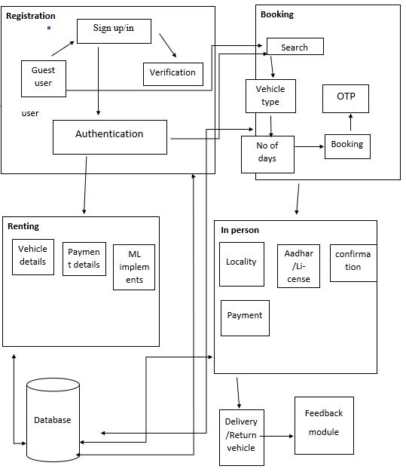

Slide 20
MODULES
Registration module
In this module, a guest user can directly have a look over the features without signing up. In case a guest user wants a ride then the user has to signup completing e-mail verification . Once a guest user sign-in into the website ,he/she requires no more authentication and can proceed to book the vehicle.
Booking module
As the user logins to book a vehicle, he/she can choose his/her interested vehicle type from the list. After selecting the vehicle type, number of days and other required details for the vehicle the user can confirm the booking. Finally, the booking is confirmed and forwarded to the vehicle owner with the registered details.

Slide 21
MODULES
Renting module
In this module, the vehicle details and the payment details are listed. The price suggestion for the selected vehicle type and number of days will be shown by using ML algorithm. So the users can know whether the price is feasible. The renting details are also stored in our database.
In person module
After successful completion of booking, the user will meet the owner in person to verify the credentials, payment etc. This verification will be done 2 hours before leaving the car on rent. The copy of the credentials will be stored in our database.

Slide 22
MODULES
Delivery and Feedback
After the ride, the user will return the vehicle to the owner without any damage. The user is completely responsible for the car’s condition until it is returned. If there is any damage it is responsibility of the user to renovate it. The vehicle owner must pay sum of money to the website per month based in the booking. If he ignores the vehicle will be removed from the list of vehicles. The feedback of the vehicle by the user will play a major role in retain the vehicle which will also be stored in our database.

Slide 23
SCREENSHOTS

Slide 24
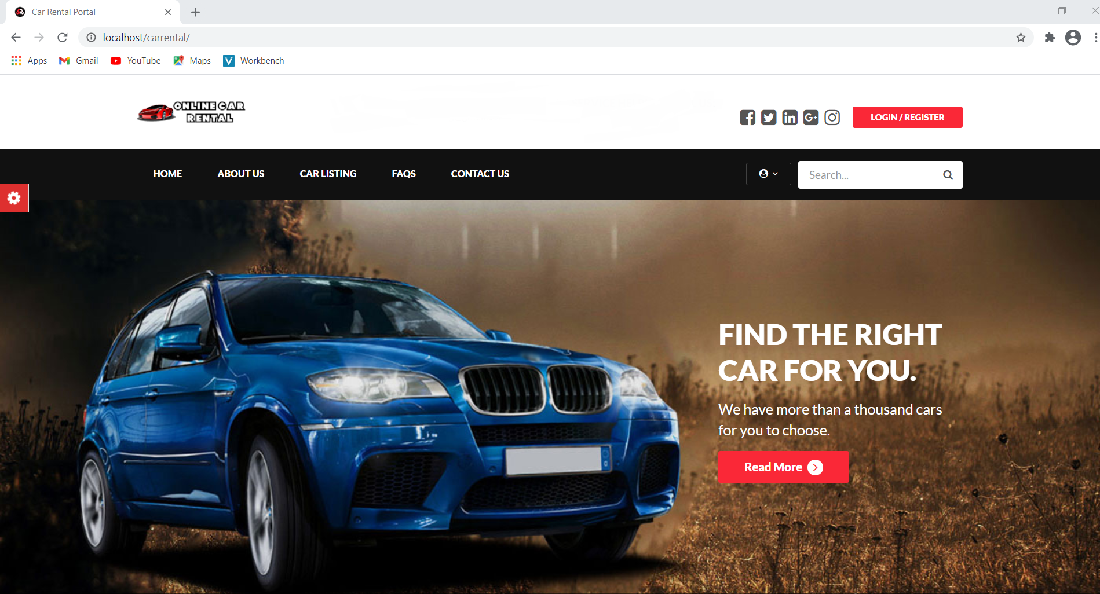

Slide 25
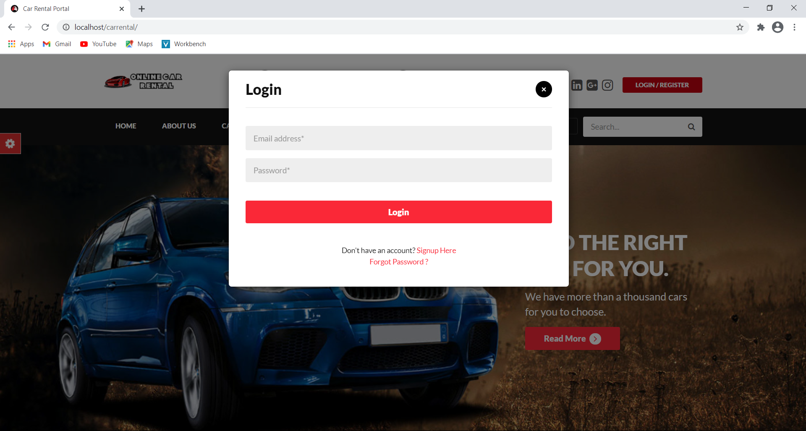

Slide 26
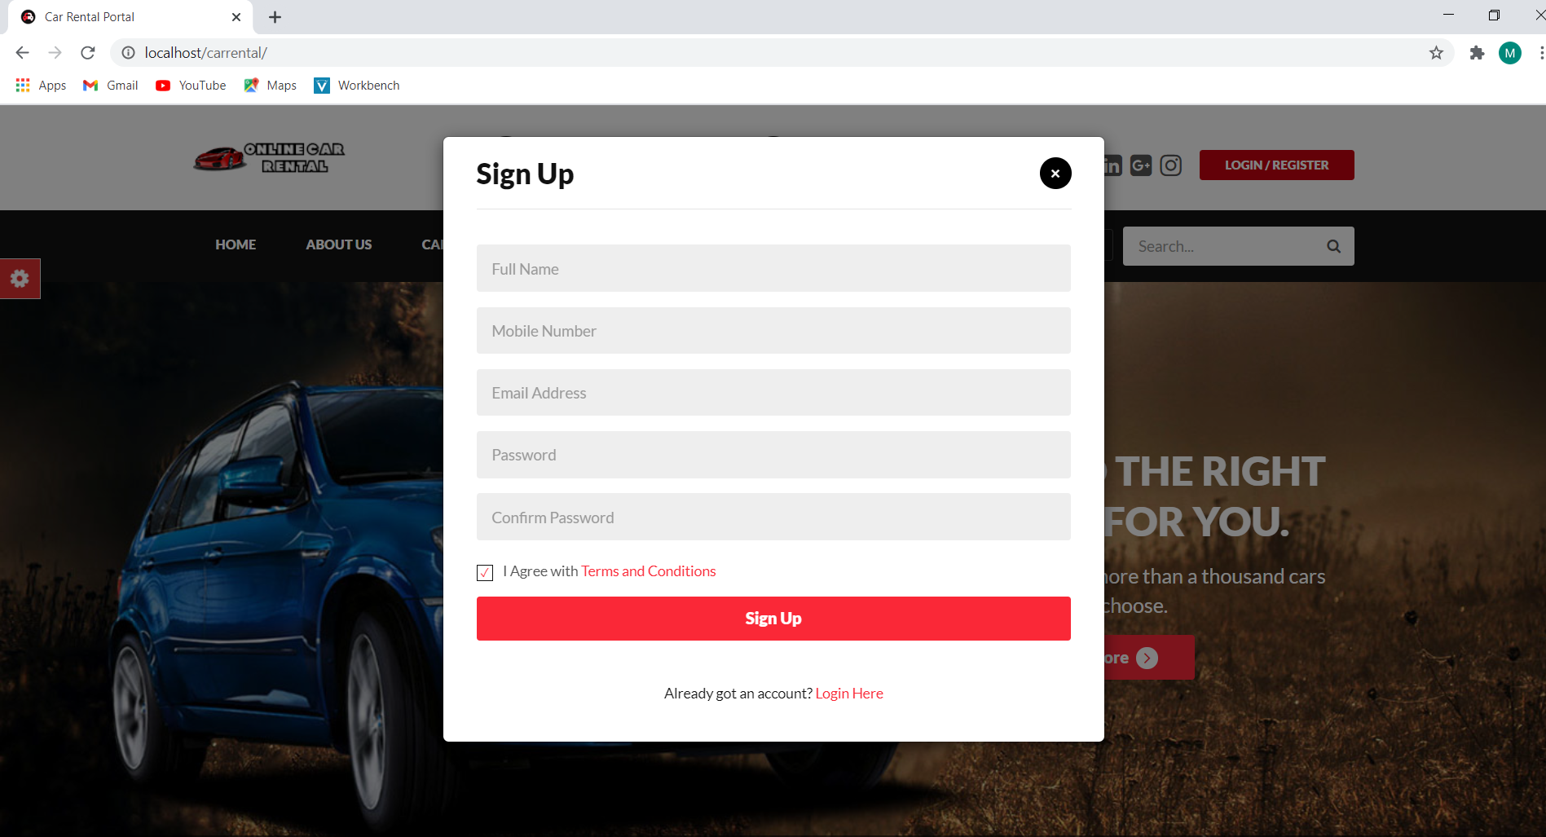

Slide 27
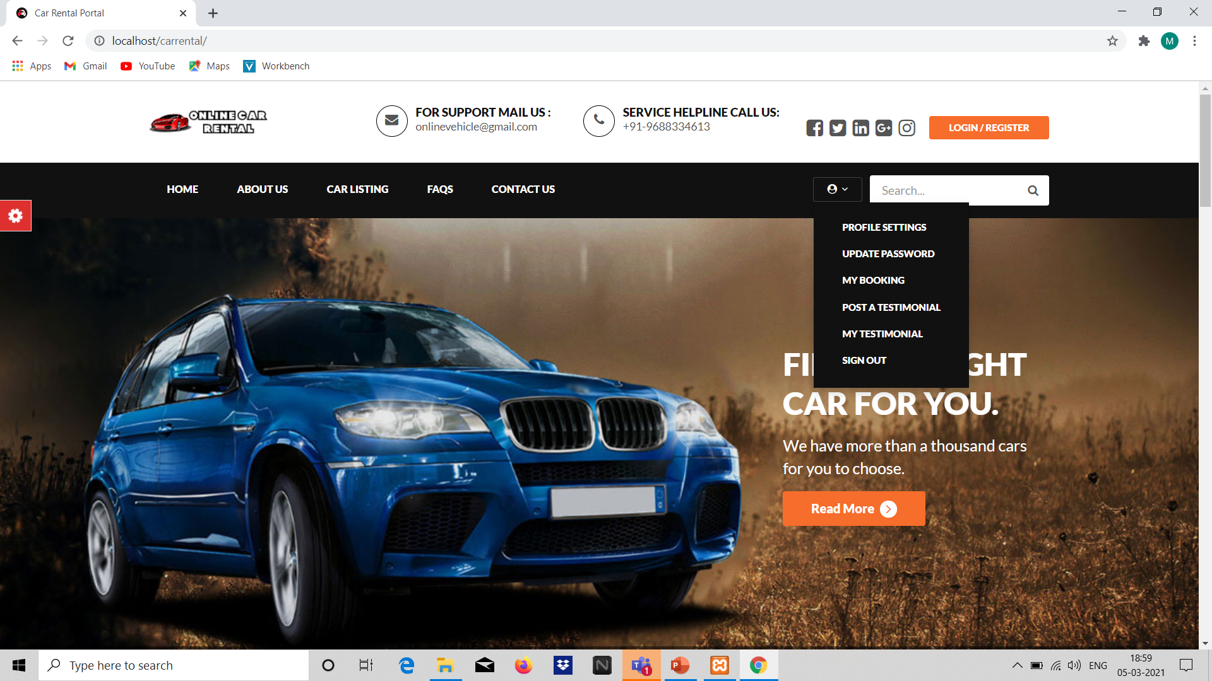

Slide 28
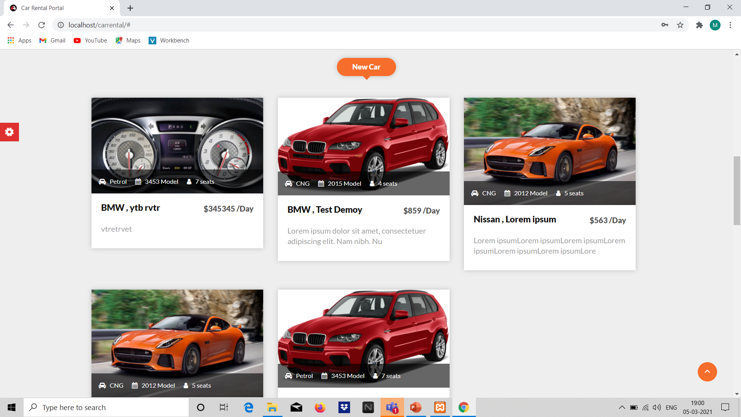

Slide 29
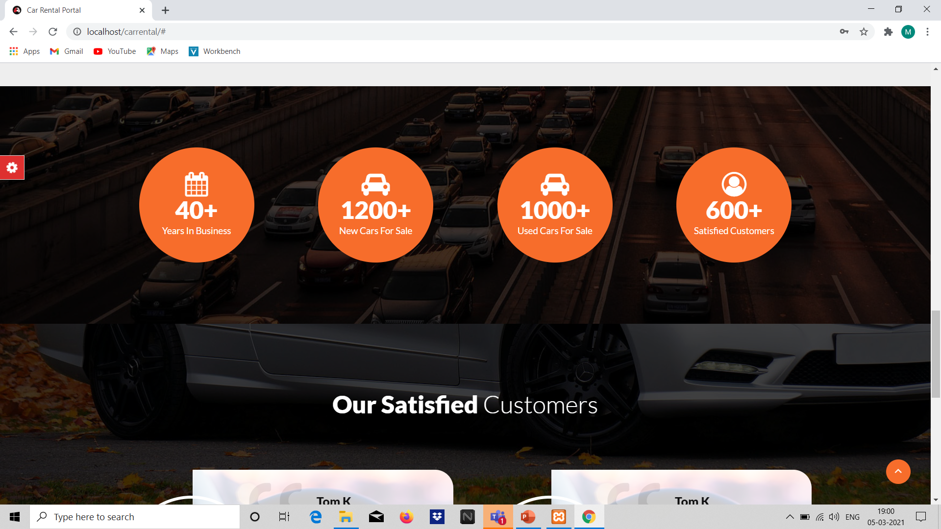

Slide 30
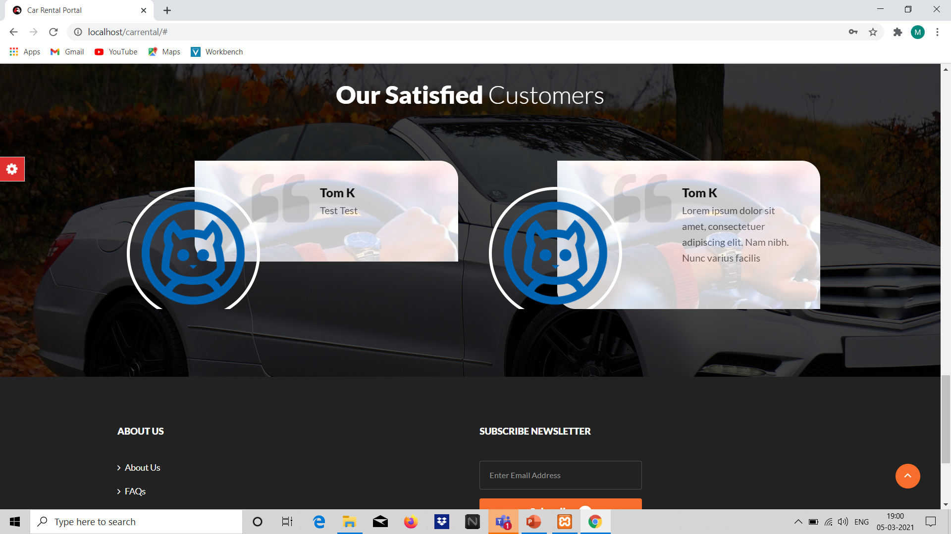

Slide 31
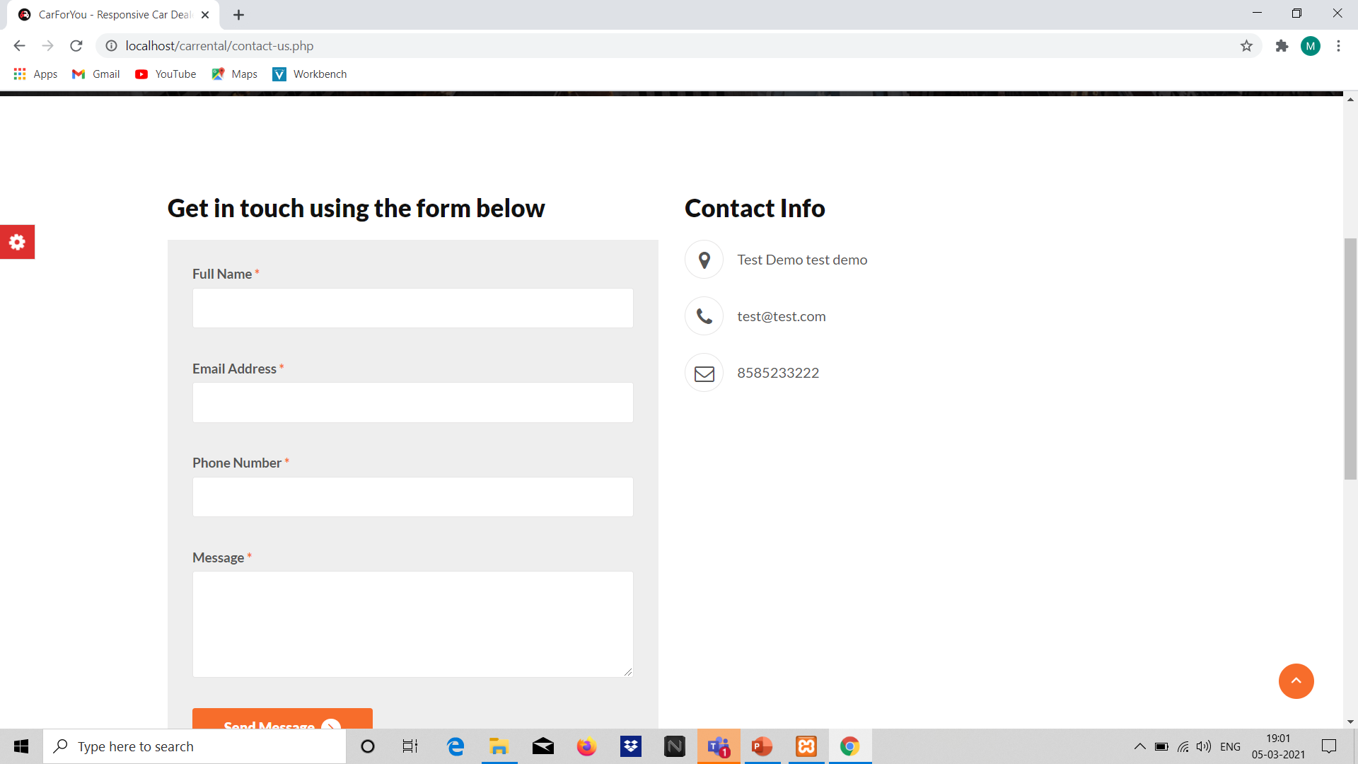

Slide 32
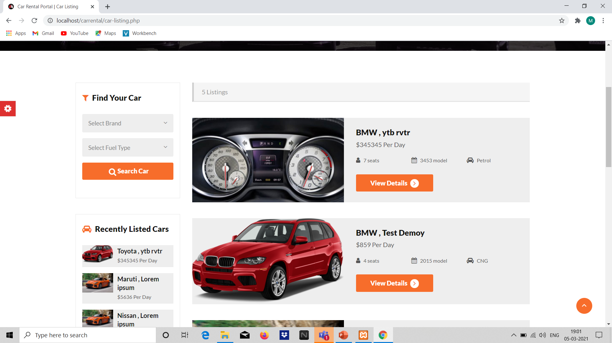

Slide 33
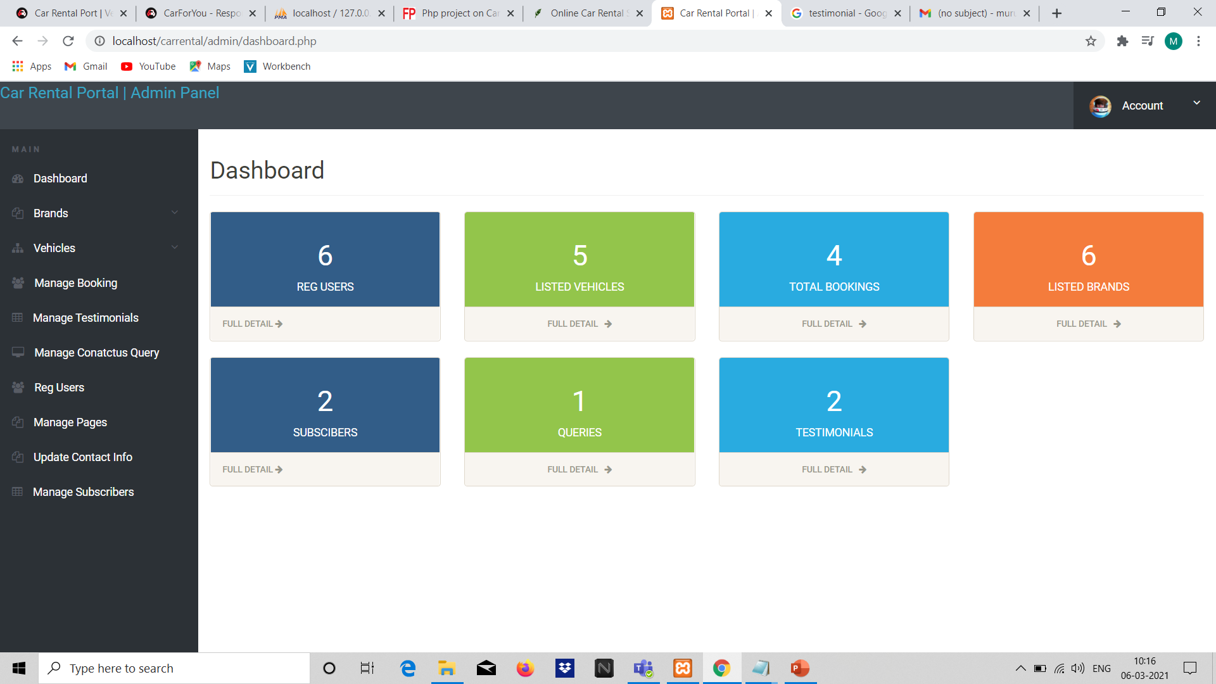

Slide 34
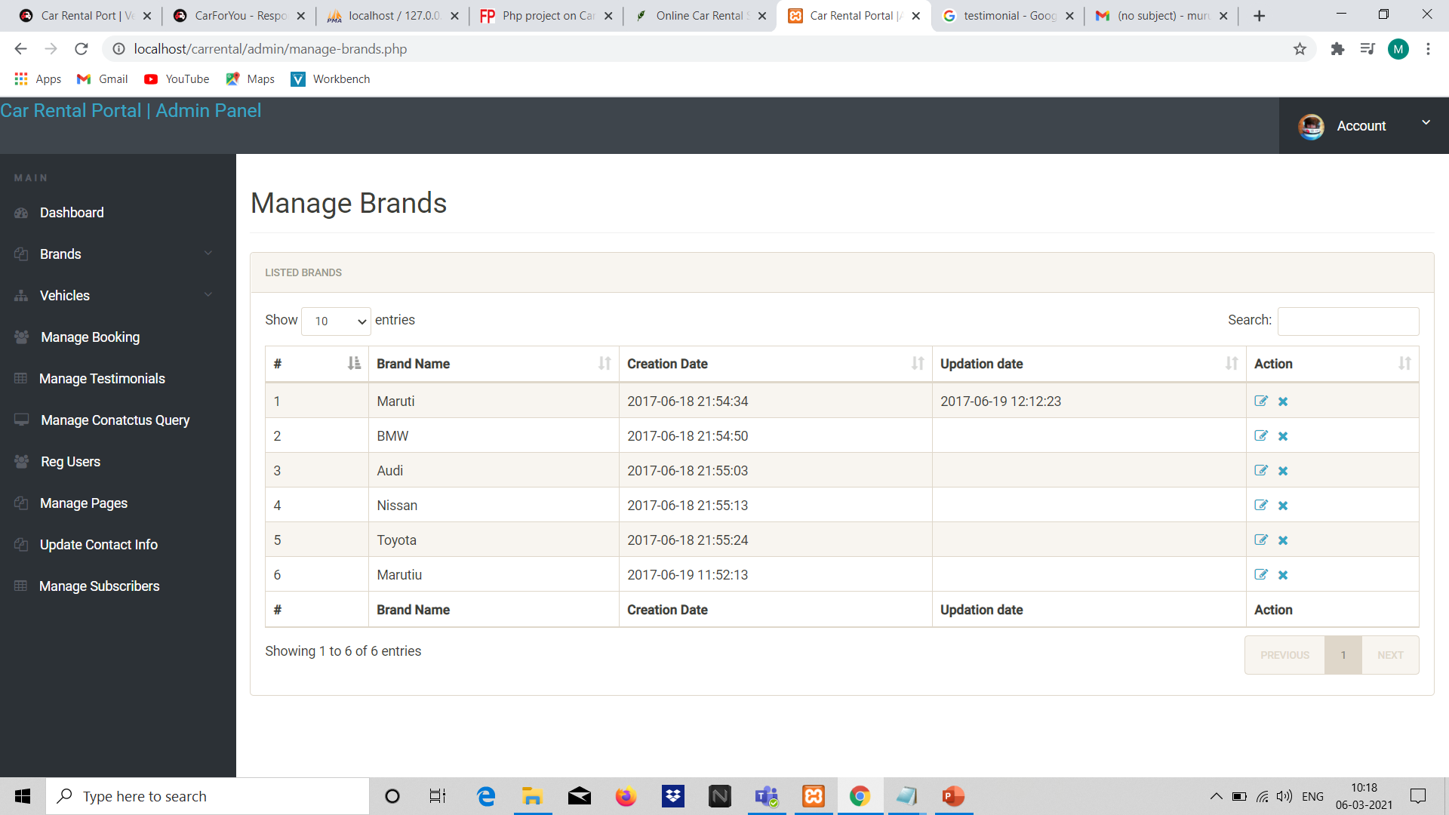

Slide 35
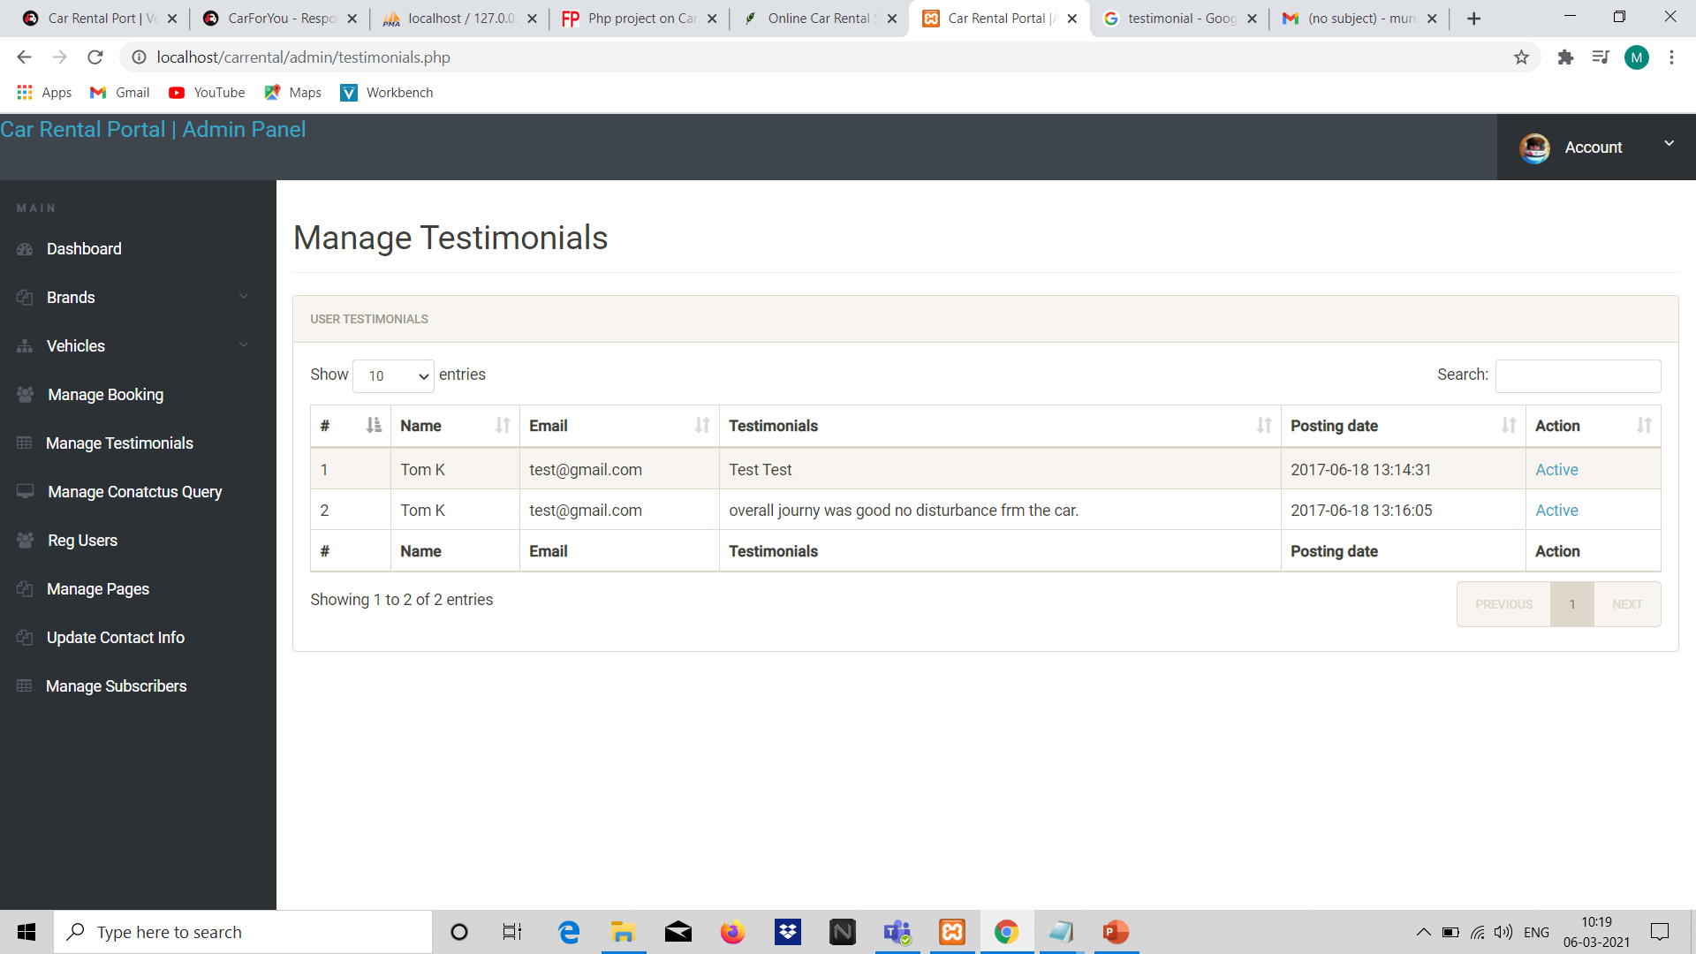

Slide 36
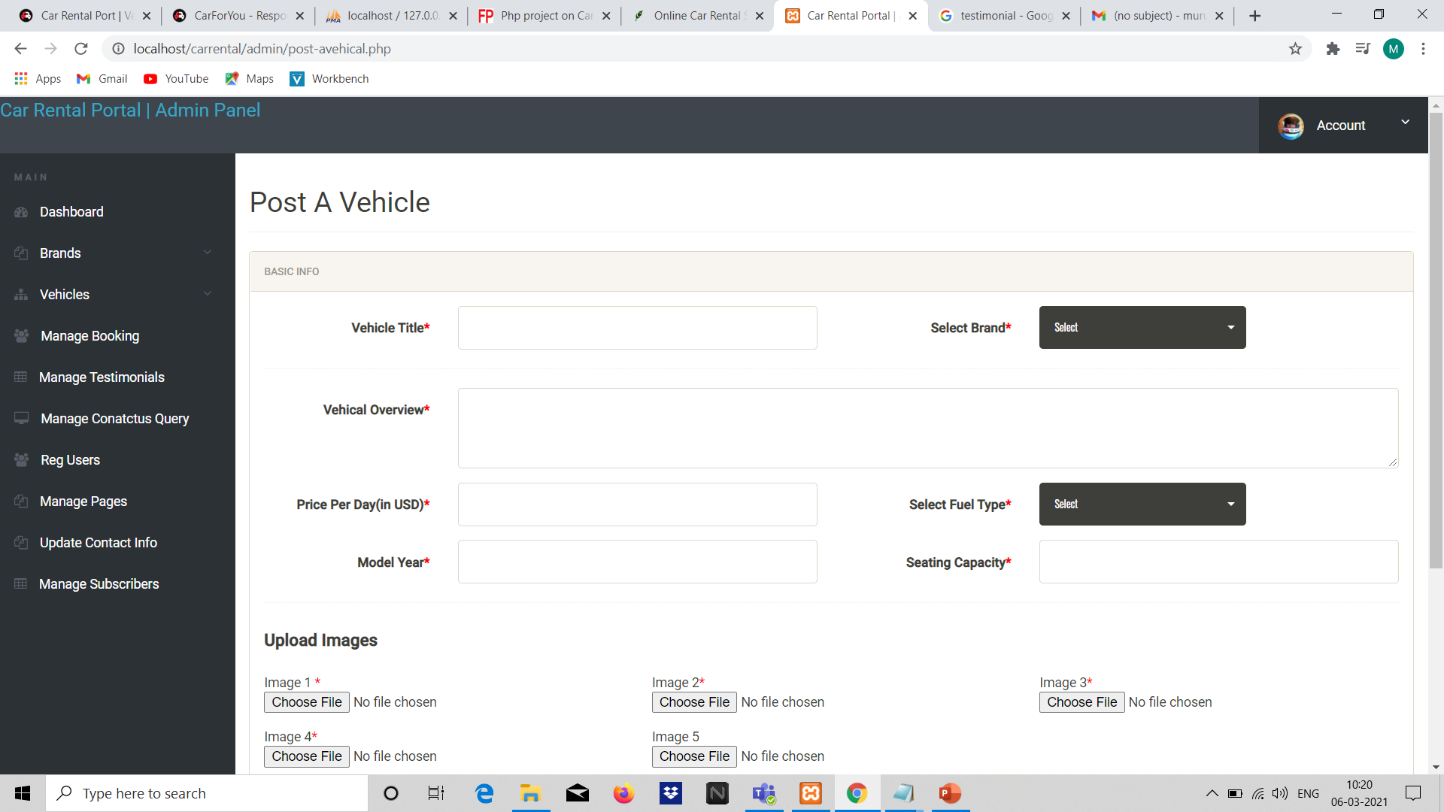

Slide 37
CONCLUSION
Online vehicle rental system has a great potential for use nowadays. It helps to get vehicles on ease for our convenience without much trouble. This project aims to create a user-friendly web-based system for customers to lend and rent vehicle for their convenient use. The web-based system is aimed to be secured and easy to manage both by the administrator and the users. Also, the system can be accessed by a browser on ease that does not demand any hardware or software requirements from the users. Making the fare price based on the days instead of kilometers will result in a greater cost efficiency for the users and the driver expenses can also be saved. This system greatly helps us tackle challenges in renting vehicles especially in this tough situations like COVID.

Slide 38
Thank you

